Slide 1
US-SIT-3P2 Software Engineering
ERM & ERD
Practical 2
S.Y. B.Sc IT : Semester 3
Notes:
Book Ian Somerville : Slides by Prof. Rakhi Gupta

Slide 2
Outline:
What Entity relationship diagrams (ERD) are.
What Entities in an ERD are?
What Attributes in an ERD are?
What Relationships in an ERD are?
How to start an ERD .

Slide 3
ERM and ERD
Entity-Relationship Data Model (ERM) is a detailed, logical representation of the data for an organization or for a business area.
  Expressed in terms of:
    Entities
    Attributes
    Relationships
Entity-Relationship Diagram (ERD) is a graphical representation of a Entity-Relationship Model.

Slide 4
ERD
The purpose of an ERD is to capture the richest possible understanding of the meaning of data necessary for an information system or organization.
ERDs are made from Entities, Attributes, and Relations.

Slide 5
Entity
What is an Entity?
Has its own identity that distinguishes it from other entities.
  Examples:
    Person: PROFESSOR, STUDENT
    Place: STORE, UNIVERSITY
    Object: MACHINE, BUILDING
    Event: SALE, REGISTRATION
    Concept: ACCOUNT, COURSE

Slide 6
Entity
(Entity Type vs. Entity Instances)
Entity Type is a collection of entities that share common properties or characteristics.
Entity Instance is a single occurrence of an entity type.
  Entities should always be placed in a rectangle!
STUDENT
CLASS
PROFESSOR
STUDENT

Slide 7
Entity Types
(Naming Guidelines)
Entity type name should be:
  A singular noun and in capital letters.
  Descriptive and specific to the organization.
  Concise.
  Named for the result of the event, not the activity or process of the event.

Slide 8
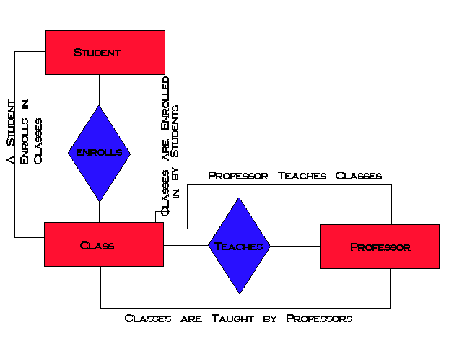
University Entity-Relationship Diagram
Entity

Slide 9
Entity Types
(Defining Guidelines)
An Entity type definition should:
  Include a statement of what the unique characteristics are for each instance.
  Make clear what entity instances are included and not included.
  Include a description of when an instance of the entity type is created and deleted.
  Specify when an instance might change into an instance of another entity type.
  Specify what history is to be kept about entity instances.

Slide 10
Attributes
Each Entity has a set of Attributes
Attribute is a property or characteristic of an entity that is of interest to the organization.
  Example:
    STUDENT: Student_ID, Student_Name, Phone_Number, Major

Slide 11
Attributes
Student
Student_ID
Student_Address
Student_Phone

Slide 12
Attributes
(Naming Guidelines)
An attribute name:
  Should be a noun and capitalize the first letter of each word. (Example: Student_ID.)
  Should be unique.
  Should follow a standard format. (Example: Student_GPA, not GPA_of_Student.)
Similar attributes of different entity types should use similar but distinguished names.
  Example: Faculty_Residence_City_Name and Student_Residence_City_Name

Slide 13
Attributes
(Defining Guidelines)
An attribute definition should:
  State what the attribute is and why it is important.
  Make clear what is and isn’t included in the attribute's value.
  Define any aliases.
  Indicate if the attribute is required or not.
  Indicate any relationships with other attributes.

Slide 14
Attributes
Candidate Key = is an attribute that uniquely identifies each instance of an entity type.
Identifier = A candidate key that has been selected as the unique, identifying characteristic of an entity type. (Should be underlined).
Other types of Attributes: multivalued, required, optional, composite, and derived.

Slide 15
Criteria for Selecting Attributes
Choose a candidate key that will not change its value.
Choose a candidate key that has valid values and not be null.
Avoid using codes, such as a 2 digit warehouse location.

Slide 16
Relationships
Relationships are associations between one or more entity types.
Are the “glue” that holds together components of an E-R model.
The degree of a relationship = is the number of entity types that participate in a relationship.
  There are 3 common relationships:
    Unary (degree one)
    binary (degree two)
    Ternary (degree three)

Slide 17
University Entity-Relationship Diagram
Relationship

Slide 18
Relationships
(Naming Guidelines)
A relationship name should:
  Be a verb phrase, such as Is_assigned_to.
  Avoid vague names, such as “Has”.

Slide 19
Relationships
(Naming Guidelines)
A relationship definition should Explain:
  What action is being taken and why it is important.
  If there is any optional participation.
  The history that is kept in the relationship.
  What any restrictions on participation in the relationship.
    For example: An EMPLOYEE may only be able to participate in two PROJECTS.

Slide 20
Unary Relationship
Relationship between the instances of one entity type.
Is_married_to Manages
One-to-one One-to-many
EMPLOYEE
PERSON

Slide 21
Binary Relationship
Relationship between the instances of two entity type.
    Is_assigned Contains
    One-to-One One-to-Many
    Can also have many to many!
EMPLOYEE
PARKING
SPACE
PRODUCT
LINE
PRODUCTS

Slide 22
Ternary Relationship
A simultaneous relationship among instances of three entity types.
        Supplies
PART
VENDOR
WAREHOUSE

Slide 23
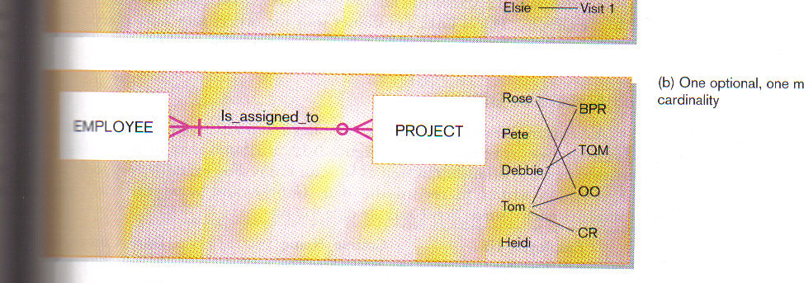
Relationship Cardinalities
Mandatory Cardinalities = The entity must participate in another entity.
Optional Cardinalities = The entity has a the option to participate in another entity.

Slide 24
Starting an ERD
Define the Entities.
Define the Relationships.
Add attributes to the relationships.
Add cardinality to the relationships.
Don’t forget to use proper naming conventions and symbol representation.

Slide 25
Guidelines for Drawing ERDs
Lay out the diagram with minimal line crossing.
Place subject entity types on the top of the diagram.
Place plural entity types below a single entity type in a one-to-many relationship.
Place entity types participating in one-to-one and many-to-many relationships alongside each other.
Group closely related entity types when possible. Try to keep the length of relationship lines as short as possible. Also try to minimize the number of changes of direction in a single line.
Show the most relevant relationship name. One name must always be shown.

Slide 26
Example 1
A university registrar’s office maintains data about the following entities:
1. courses, including number, title, credits, syllabus, and prerequisites;
2. course offerings, including course number, year, semester, section number, instructor(s), timings, and classroom;
3. students, including student-id, name, and program;
4. Instructors, including identification number, name, department, and phone number. Further, the enrollment of students in courses and grades awarded to students in each course they are enrolled for must be appropriately modeled.
Construct an E-R diagram for the registrar’s office. Document all assumptions that you make about the mapping constraints.

Slide 27
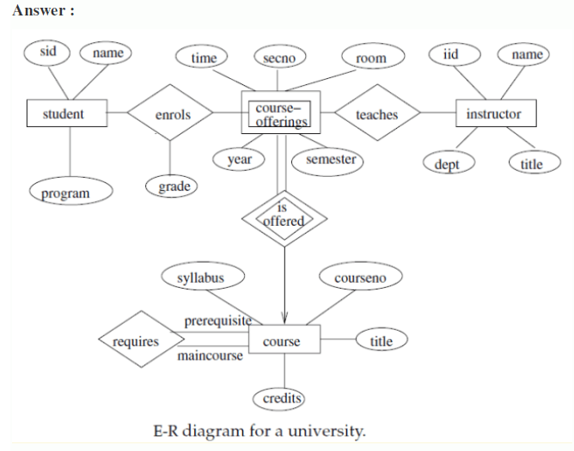

Slide 28
Example 2
Create an ERD using the following requirements:
An INVOICE is written by a SALESREP. Each sales representative can write many invoices, but each invoice is written by a single sales representative.
The INVOICE is written for a single CUSTOMER. However, each customer can have many invoices.
An INVOICE can include many detail lines (LINE), each of which describes one product bought by the customer.
The product information is stored in a PRODUCT entity.
The product’s vendor information is found in a VENDOR entity.

Slide 29
